Slide 1
CER3C3 Data Structures
Lecture 1 & 2

Slide 2
What is Data Structures??
In computer science, a data structure is a data organization, management, and storage format that enables efficient access and modification.
More precisely, a data structure is a collection of data values, the relationships among them, and the functions or operations that can be applied to the data, i.e., it is an algebraic structure about data.
Data Structure can be defined as the group of data elements which provides an efficient way of storing and organising data in the computer so that it can be used efficiently.
Data Structures are building blocks of any program or the software.
Data Structure + Algorithm = Program

Slide 3
Why you should study?
One of the core of programming
Foundation course
Competitive Programming

Slide 4
What is Algorithm??
An algorithm is a finite set of instructions which, if followed, accomplish a particular task. In addition every algorithm must satisfy the following criteria:
(i) input: there are zero or more quantities which are externally supplied;
(ii) output: at least one quantity is produced;
(iii) definiteness: each instruction must be clear and unambiguous;
(iv) finiteness: if we trace out the instructions of an algorithm, then for all cases the algorithm will terminate after a finite number of steps;
(v) effectiveness: every instruction must be sufficiently basic that it can in principle be carried out by a person using only pencil and paper. It is not enough that each operation be definite as in (iii), but it must also be feasible.

Slide 5
Algorithm .. continue
In formal computer science, one distinguishes between an algorithm, and a program. A program does not necessarily satisfy condition (iv). One important example of such a program for a computer is its operating system which never terminates (except for system crashes) but continues in a wait loop until more jobs are entered.
An algorithm can be described in many ways. A natural language such as English can be used but we must be very careful that the resulting instructions are definite (condition iii). An improvement over English is to couple its use with a graphical form of notation such as flowcharts.

Slide 6
Terminologies -- Data Type
A data type is a term which refers to the kinds of data that variables may "hold" in a programming language.
With every programming language there is a set of built-in data types. This means that the language allows variables to name data of that type and provides a set of operations which meaningfully manipulates these variables.
Some data types are easy to provide because they are already built into the computer's machine language instruction set. Integer and real arithmetic are examples of this. Other data types require considerably more effort to implement.

Slide 7
Terminologies -- Data Objects
Data object is a term referring to a set of elements, say D. For example the data object integers refers to D = {0, 1, 2, ...}.
The data object alphabetic character strings of length less than thirty one implies D = {",'A','B', ...,'Z','AA', ...}. Thus, D may be finite or infinite and if D is very large we may need to devise special ways of representing its elements in our computer.

Slide 8
Another viewpoint -- Data Structures
The notion of a data structure as distinguished from a data object is that we want to describe not only the set of objects, but the way they are related.
In another way, we want to describe the set of operations which may legally be applied to elements of the data object. This implies that we must specify the set of operations and show how they work.
For integers we would have the arithmetic operations +, -, *, / and perhaps many others such as mod, ceil, floor, greater than, less than, etc. The data object integers plus a description of how +, -, *, /, etc. behave constitutes a data structure definition.

Slide 9
Data Structure - An Example
Define the data structure natural number (abbreviated natno) where natno = {0,1,2,3, ...} with the three operations being a test for zero addition and equality.
structure NATNO
1 declare ZERO( ) → natno
2 ISZERO(natno) → boolean
3 SUCC(natno) → natno
4 ADD(natno, natno) → natno
5 EQ(natno, natno) → boolean
6 for all x, y ∈ natno let
7 ISZERO(ZERO) ::= true; ISZERO(SUCC(x)) ::= false
8 ADD(ZERO, y) :: = y, ADD(SUCC(x), y) :: = SUCC(ADD(x, y))
9 EQ(x, ZERO) :: = if ISZERO(x) then true else false
10 EQ(ZERO, SUCC(y)) :: = false
EQ(SUCC(x), SUCC(y)) :: = EQ(x, y)
11 end
end NATNO

Slide 10
Guess the output??
SUCC(SUCC(SUCC(ZERO))) = ??
ADD(SUCC(SUCC(ZERO)),SUCC(SUCC(SUCC(ZERO)))) == ??
SUCC(SUCC(ADD(ZERO,SUCC(SUCC(SUCC(ZERO)))))) = ??\
SUCC(SUCC(SUCC(SUCC(SUCC(ZERO))))) = ??

Slide 11
What is Abstract Data Type(ADT)?
An ADT is a mathematical model for data types.
An ADT is defined by its behavior from the point of view of a user, of the data, in terms of possible values, possible operations on data of this type, and the behavior of these operations.
For example, integers defined as the values ..,-2,-1,0,1,2,.. and by the operations of addition, subtraction, multiplication and division, together with greater than, less than etc. which behave according to mathematics.
Integers ``behavior`` includes obeying various axioms (associativity, commutivity) and preconditions on operations (can not divide by zero).

Slide 12
Exercise
How Array can be declared as an ADT??
You need to declare three functions -- CREATE, STORE, ACCESS

Slide 13
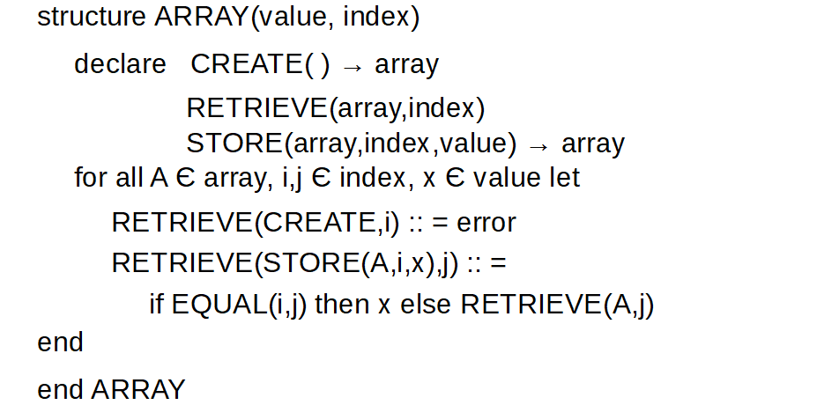
Array as an ADT

Slide 14
Comparison with Data Structures..
Data Structures serve as the basis for ADT. The ADT defines the logical form of the data type.
The data structure implements the physical form of the data type.

Slide 15
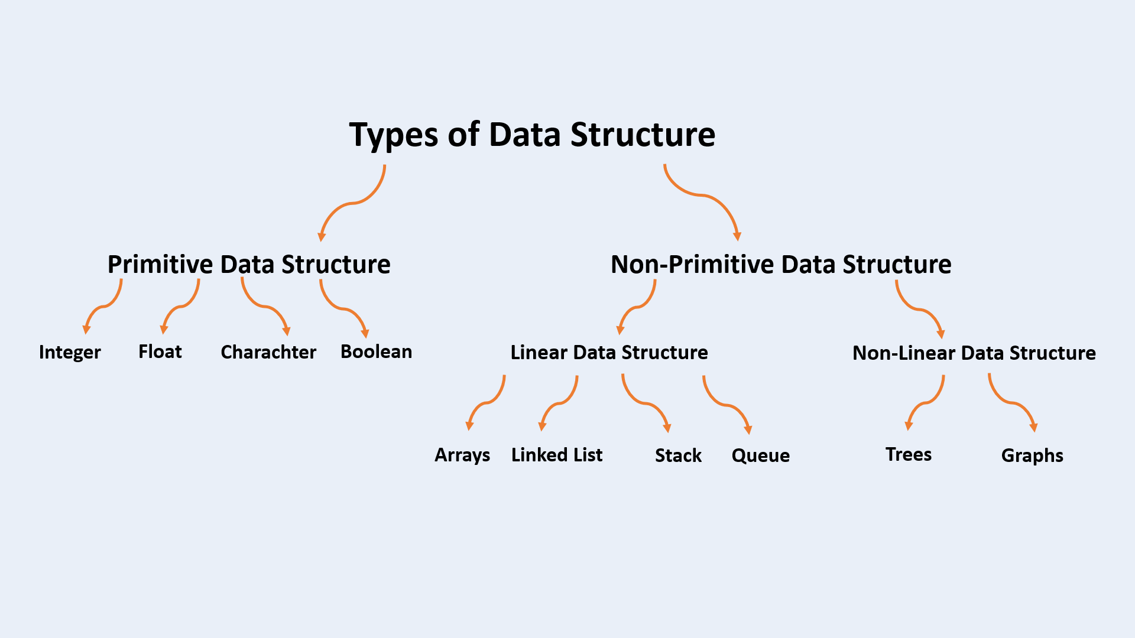
Types of Data Structures

Slide 16
Problem Solving : Exercise 1
Polynomial Addition
For example,
A(x) = 3x^2 + 2x + 4
B(x) = x^4 + 10x^3 + 3x^2 + 1

